Slide 1

Utility billing system
A Secure Full-Stack Web Application using ASP.NET Core & Angular
Armaan Pandey

Slide 2
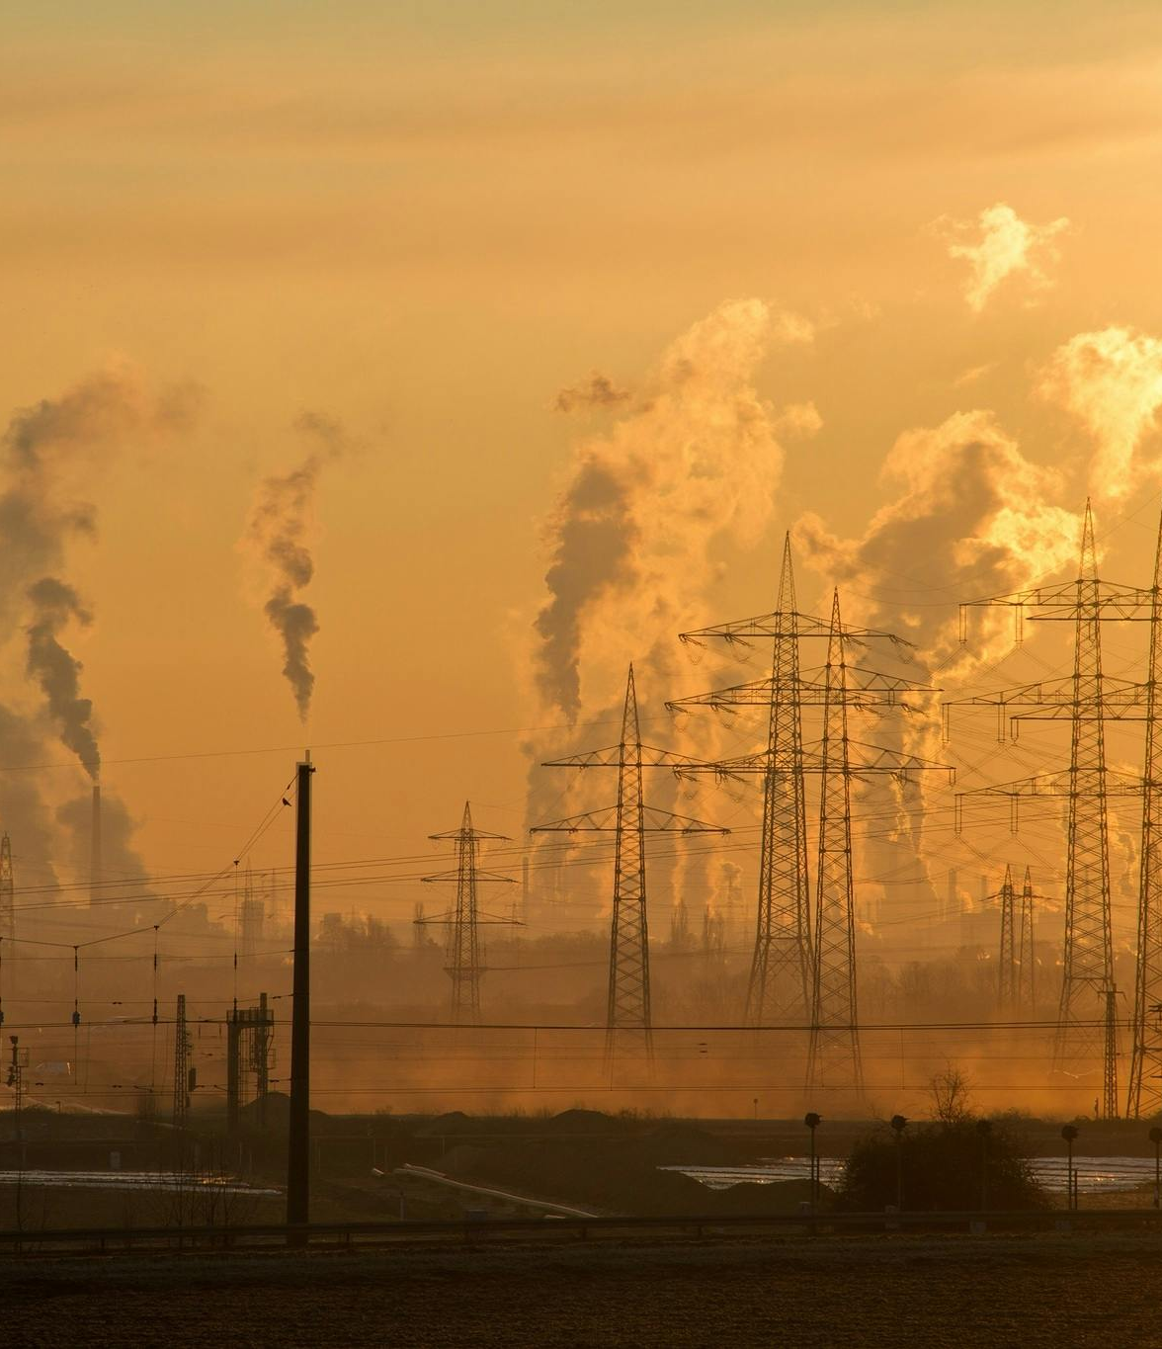
TABLE OF CONTENTS
1.Problem Statement
2.Project objectives
3. Technology Stack
4. System Architecture
5. Core User Roles
6. System Flowchart
7. Analytics & LINQ
8. Quality Assurance & Testing
9. Project Screenshots
10.Thank you

Slide 3
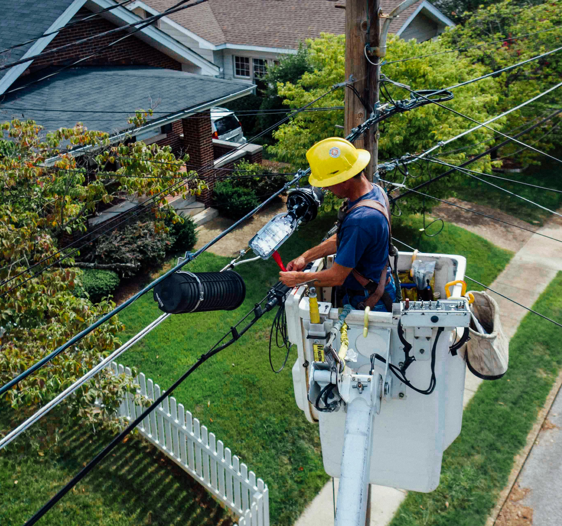

Business Context & Problem Statement
Industry Challenge: Utility providers (Electricity, Water, Gas, Internet) manage thousands of connections and complex monthly cycles.
Current Limitations: Many providers rely on semi-manual systems.
Key Pain Points:
Incorrect meter readings and billing errors.
Delayed bill generation and poor payment tracking.
Lack of visibility into outstanding dues and consumption patterns
Subpar customer experience for viewing and paying bills.
Notes:
© Copyright Showeet.com – Free PowerPoint Templates

Slide 4

Project Objectives
Centralized Management: Build a system to manage consumer accounts, meter readings, and accurate periodic billing.
Financial Tracking: Efficiently track payments and outstanding balances.
Data-Driven Insights: Provide dashboards and reports for revenue and consumption analytics.
Technical Excellence: Develop a secure, scalable, and cloud-ready application using enterprise best practices.
Notes:
© Copyright Showeet.com – Free PowerPoint Templates

Slide 5

Technology Stack
Backend: ASP.NET Core Web API (.NET 8/9) with Entity Framework Core and SQL Server.
Frontend: Angular using TypeScript and Angular Material/Bootstrap for a responsive UI.
Security: JWT (JSON Web Token) for Authentication and Role-Based Access Control (RBAC).
Tools: LINQ for complex billing logic, Swagger for API documentation, and Postman for testing.
Notes:
© Copyright Showeet.com – Free PowerPoint Templates

Slide 6
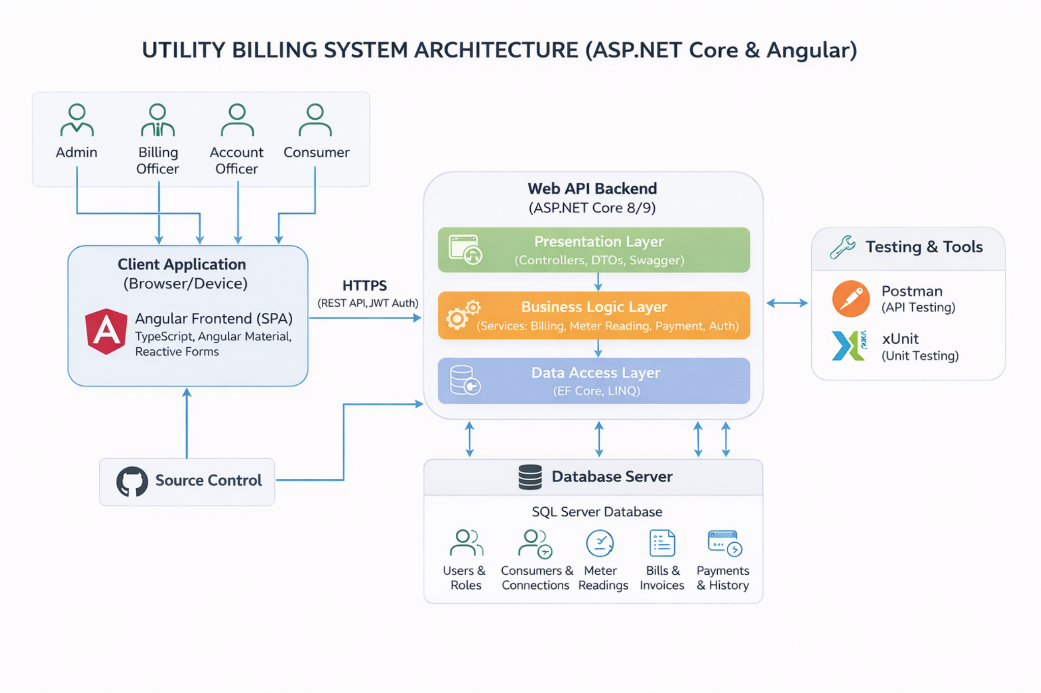
System Architecture & Design
Frontend & Backend Architecture:
Modular design including Core(Auth, Guards, Interceptors), Shared, and Feature modules.
Reactive Forms for complex data entry (Meter Readings/Registration) & HTTP Client Interceptors for seamless JWT handling.
Clean Architecture with DTO usage to protect domain entities.
Global exception handling middleware for robustness.

Slide 7
Core User Roles & Workflow
Admin: Manages users, utility types, tariffs, and billing cycles.
Billing Officer: Responsible for entering meter readings and generating bills.
Account Officer: Tracks payments and monitors outstanding balances.
Consumer: Views personal bills, payment history, and consumption trends.

Slide 8
System Flowchart
Here is a detailed system flowchart demonstrating the end-to-end operational workflow of the Utility Billing System.
It illustrates the automated lifecycle of a bill—from secure user authentication and meter reading validation to consumption calculation and final payment tracking.

Slide 9

Data Analytics & LINQ Implementation
Advanced Querying: Leveraging LINQ for sophisticated reporting.
Key Metrics Demonstrated:
Total Revenue per month.
Total Outstanding dues.
Average consumption patterns across utility types.
Consumer-wise billing summaries.
Notes:
© Copyright Showeet.com – Free PowerPoint Templates

Slide 10

Quality Assurance & Testing
Unit Testing: Implemented using xUnit for backend logic.
API Validation: Rigorous testing of all endpoints via Postman.
Security Testing: Verified JWT-based authentication and authorization for different roles.
Performance: Ensured RESTful API efficiency and secure data handling.
Notes:
© Copyright Showeet.com – Free PowerPoint Templates

Slide 11
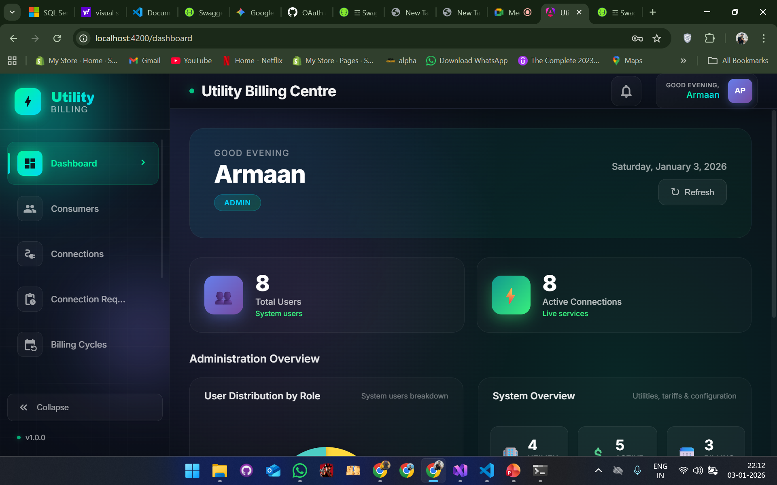
Large Image slide
PROJECT SCRENSHOTS (Admin Dashboard)
Notes:
© Copyright Showeet.com – Free PowerPoint Templates

Slide 12
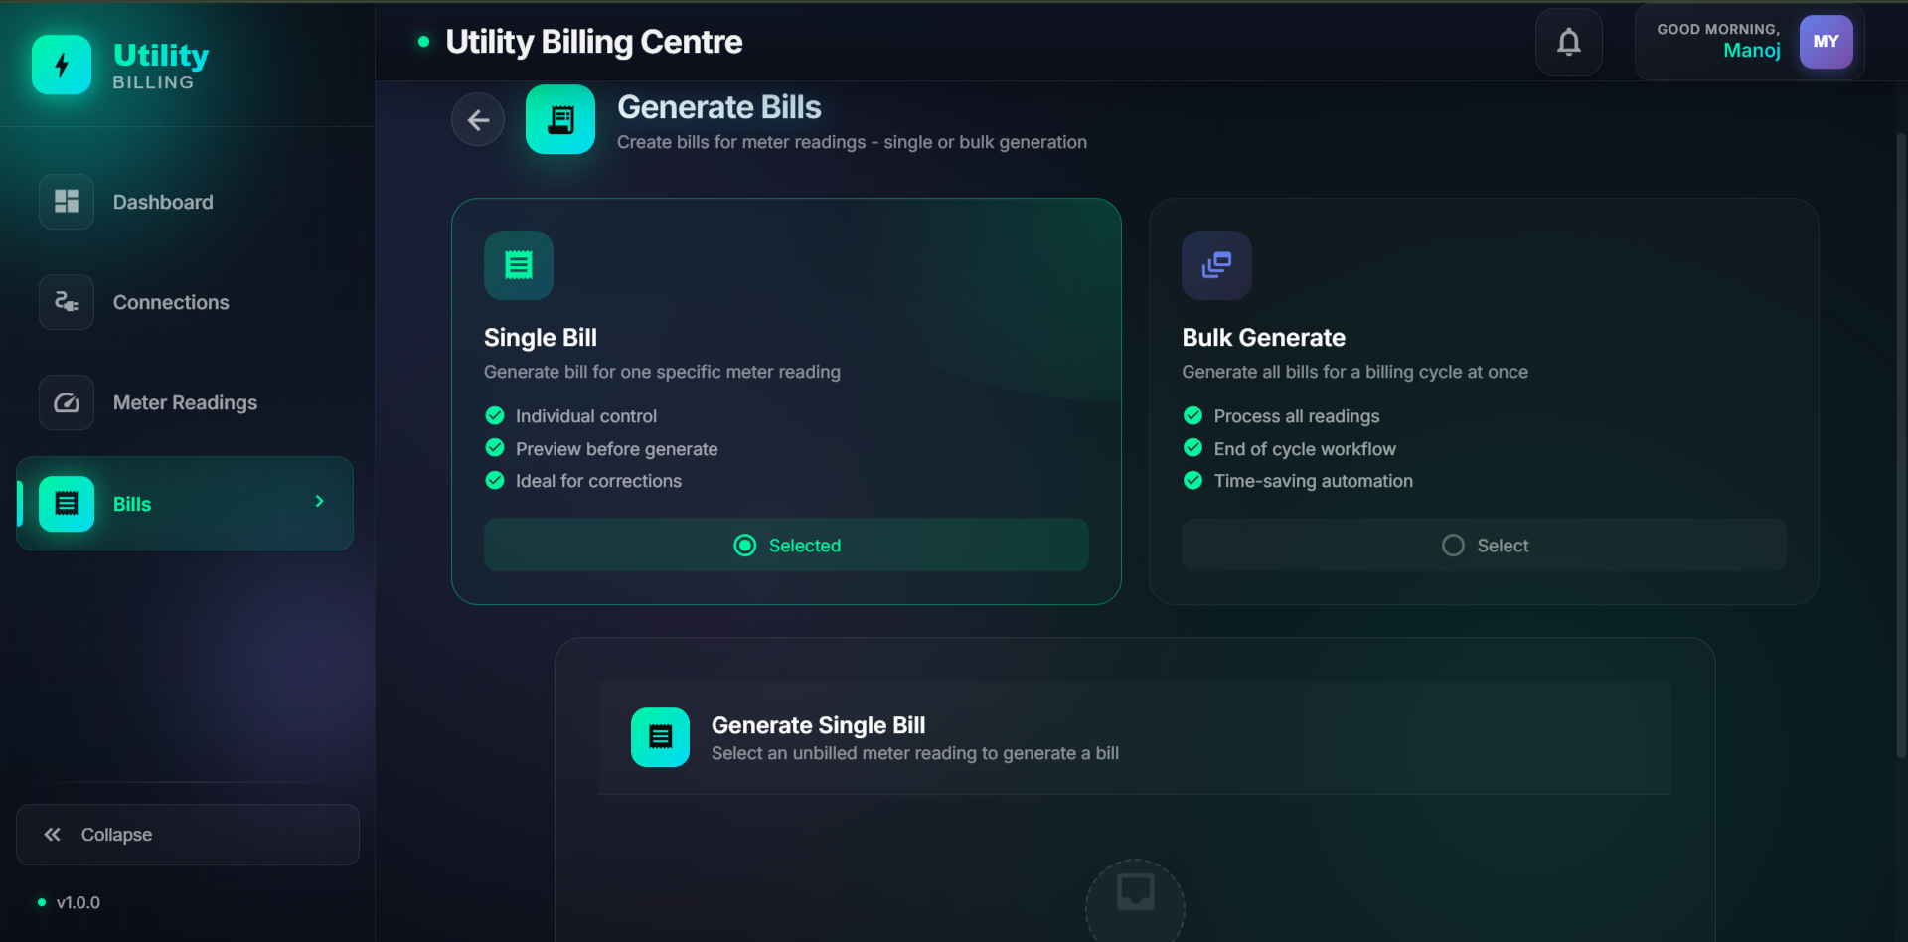
Large Image slide
PROJECT SCRENSHOTS (Bill Generation)
Notes:
© Copyright Showeet.com – Free PowerPoint Templates

Slide 13
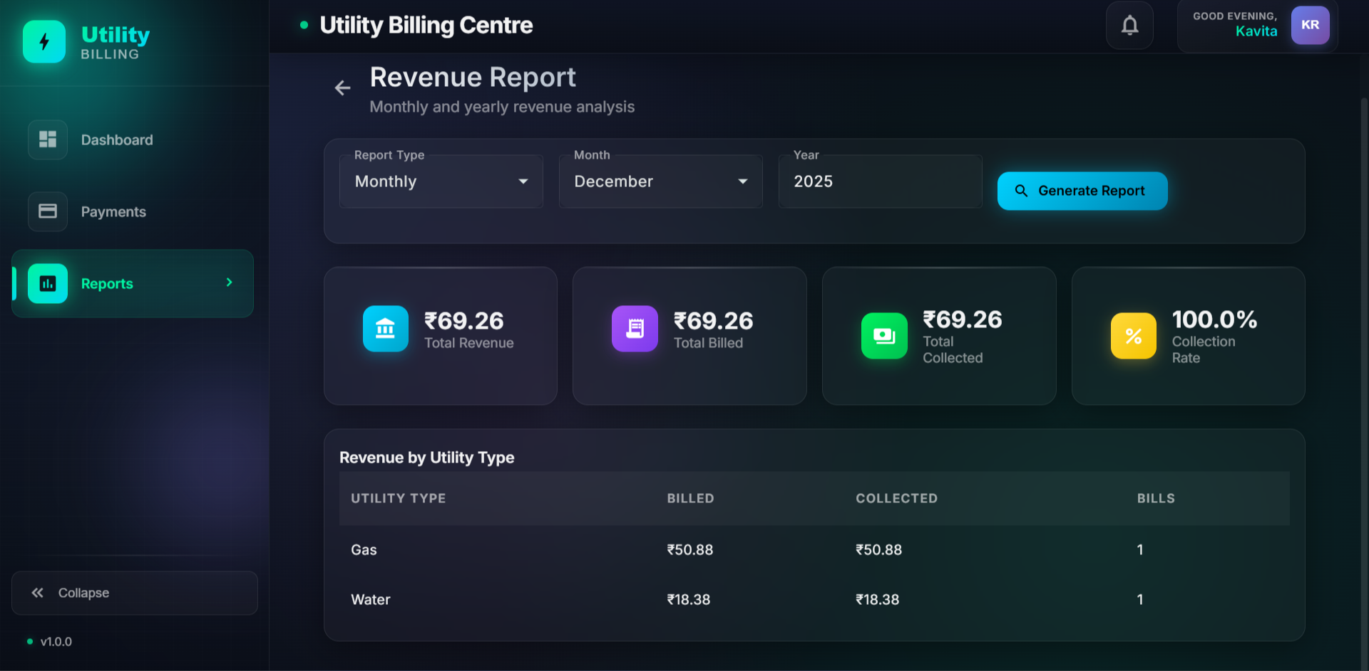
Large Image slide
PROJECT SCRENSHOTS (Revenue Report)
Notes:
© Copyright Showeet.com – Free PowerPoint Templates

Slide 14

Live Demonstration

Slide 15

THANK YOU

